Slide 1



CAPSTONE PROJECT
IntelliAllergen: AI-Powered Allergen Detection System for Safer Food Choices
PRESENTED BY STUDENT NAME: COLLEGE NAME: DEPARTMENT: EMAIL ID:
Sarvesh Kumar Roy
Lingaya’s Vidyapeeth
Computer Science and Engineering
sarveshkumarro007@gmail.com

Slide 2
OUTLINE:
Problem Statement
Proposed System/Solution
System Development Approach
Algorithm & Deployment
Result (Output Image)
Conclusion
Future Scope
References

Slide 3
PROBLEM STATEMENT:
Food allergies affect millions of people worldwide and can cause severe or life-threatening reactions.
However:
Packaged food contains complex ingredient lists
Allergen identification is often manual and confusing
Users must carefully read and interpret ingredients
Hidden allergens may not be easily recognizable
Human error can lead to dangerous health risks
Therefore, there is a need for an intelligent system that can automatically detect potential allergens from ingredient-level food data and provide instant alerts.

Slide 4
PROPOSED SOLUTION:
IntelliAllergen is an AI-powered web application that:
✔ Detects allergens using a trained Machine Learning model ✔ Provides real-time allergen predictions ✔ Supports multiple ingredient inputs ✔ Displays instant safety alerts ✔ Uses a clean and interactive Streamlit interface

Slide 5
SYSTEM APPROACH:
1️⃣ Data Collection
Dataset: Allergen Status of Food Products
Ingredient-level food records
Labeled allergen presence/absence
2️⃣ Data Preprocessing
Handling missing values
Encoding categorical features using Leave-One-Out Encoder
Feature transformation
Splitting into training & testing datasets
3️⃣ Model Development
Random Forest Classifier used
Trained on processed ingredient data
Optimized for fast inference
Saved using Joblib (.pkl files)

Slide 6
ALGORITHM & DEPLOYMENT:
Algorithm Used
Random Forest Classifier
Ensemble learning method
Multiple decision trees
Final prediction via majority voting
Reduces overfitting
High accuracy for classification tasks
Model Pipeline
User enters ingredients
Input is encoded
Model performs prediction
Output generated:
Allergen detected
Safe / Unsafe alert
Deployment
Frontend built using Streamlit
Model loaded from:
Allergen_detection.pkl
leave_one_out_encoder.pkl
Hosted on Streamlit Cloud
Real-time prediction enabled
🌐 Live Demo: https://intelliallergen-dersed6g6a64x9vy8x82et.streamlit.app/

Slide 7
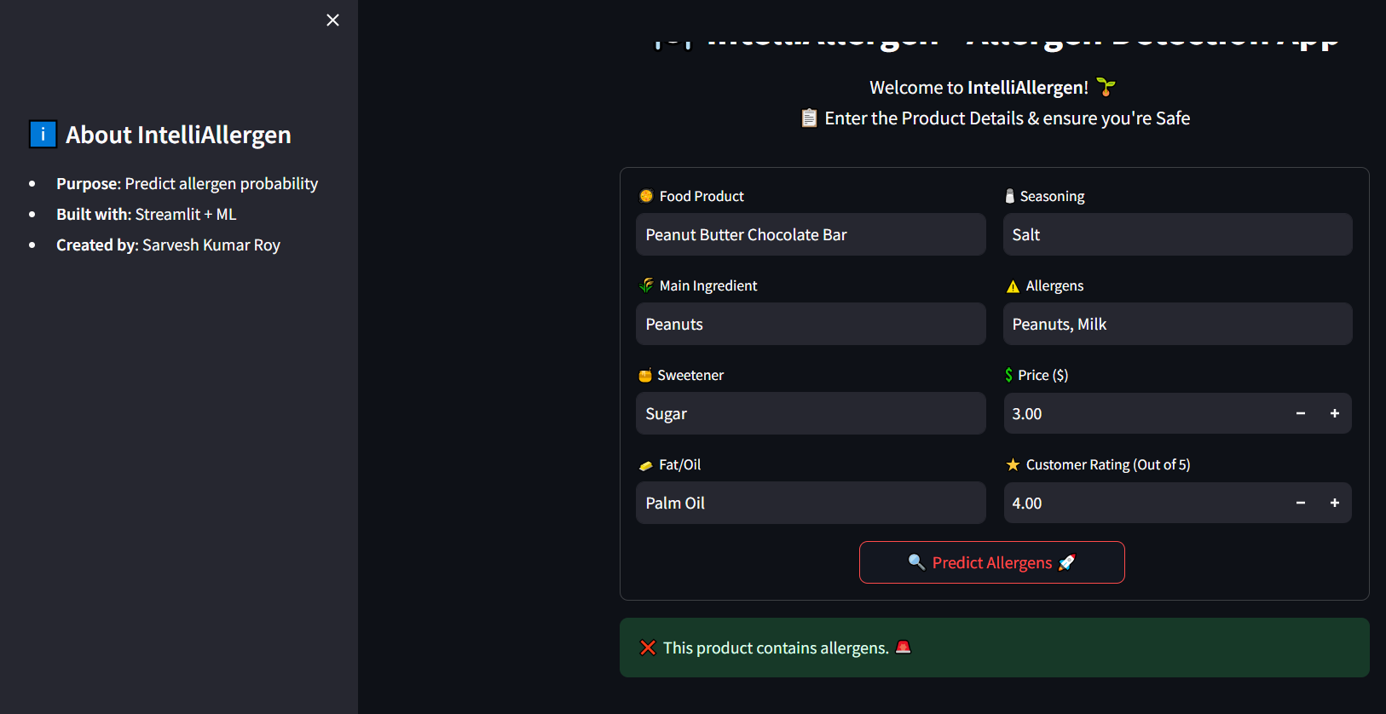
RESULT:
Key Outputs:
✔ Instant allergen detection ✔ Clear alert messages ✔ Multi-ingredient input support ✔ Fast response time ✔ User-friendly UI

Slide 8
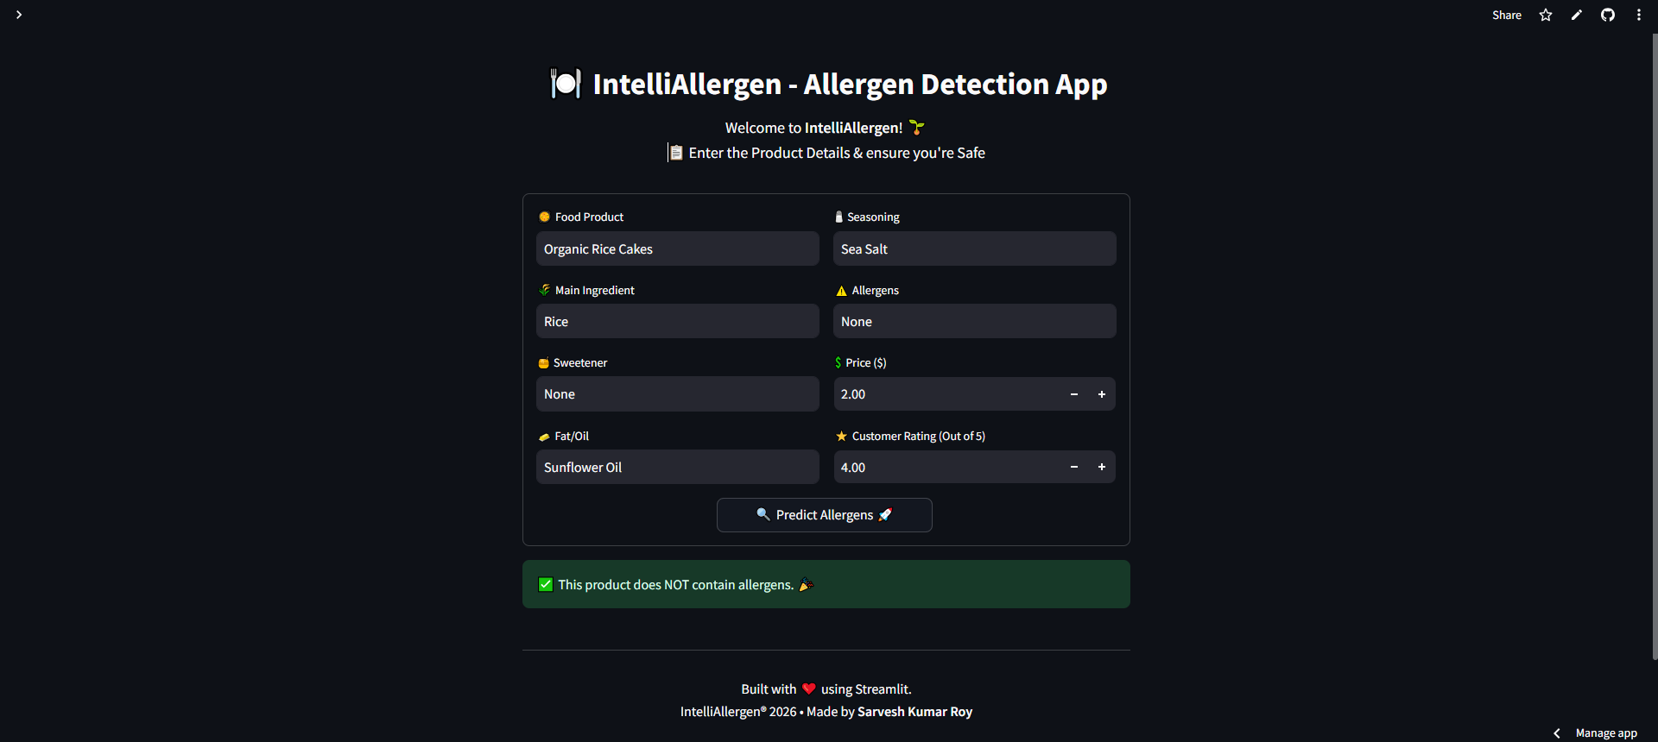

Slide 9
CONCLUSION:
IntelliAllergen successfully demonstrates how Machine Learning can enhance food safety.
The system:
Automates allergen detection
Reduces risk of human error
Provides real-time predictions
Empowers users to make safer food decisions
This project highlights strong skills in:
Machine Learning
Data preprocessing
Model deployment
Streamlit web development

Slide 10
FUTURE SCOPE:
Integrate barcode scanning for packaged foods
Add NLP-based ingredient parsing
Expand to multi-allergen classification
Mobile app deployment
Integrate real-time food database APIs
Personalized allergen profiles for users

Slide 11
REFERENCES:
scikit-learn Documentation
Streamlit Official Documentation
Kaggle – Food Allergen Datasets
Random Forest Research Papers
GitHub Repository: https://github.com/roysarvesh/IntelliAllergen

Slide 12
Thank You

